Slide 1



MEDICAL STOP-LOSS CAPTIVES
EDUCATIONAL TRAINING
Presented By:

Slide 2


MEDICAL STOP-LOSS REFRESHER
SPECIFIC STOP-LOSS
PROTECTS AGAINST LARGE INDIVIDUAL CLAIMS
AGGREGATE STOP LOSS
CAPS TOTAL PLAN LIABILITY
“Stop-loss is the safety net. The question is who owns the net”

Slide 3


HOW TRADTIONAL STOP-LOSS IS PRICED
WHAT EMPLOYERS PAY FOR:
THE REALITY:
Expected claims
Volatility load
Risk margin
Carrier profit
Capital costs
Most stop-loss years are profitable for carriers
Profitability is not transparent to employers
Excess profits are retained by the carrier
TRADITIONAL STOP-LOSS IS A ONE-WAY FINANCIAL TRANSACTION.

Slide 4


Captives are not about avoiding insurance, they are about optimizing risk financing.

Slide 5



WHAT A STOP-LOSS CAPTIVE IS
A Stop-Loss Captive is a member-owned risk-sharing structure that allows employers to collectively retain predictable risk while transferring catastrophic risk to reinsurers.
Does Not Replace Stop-Loss Insurance
Replaces Carrier Profit and Capital Layers

Slide 6

SINGLE-PARENT (PURE) CAPTIVE
Owned and capitalized by a single employer or corporate group
Employer retains predictable risk and controls underwriting decisions
Typically used by large or highly sophisticated organizations
High transparency, customization, and governance responsibility
Less common in mid-market medical stop-loss due to capital requirements

Slide 7

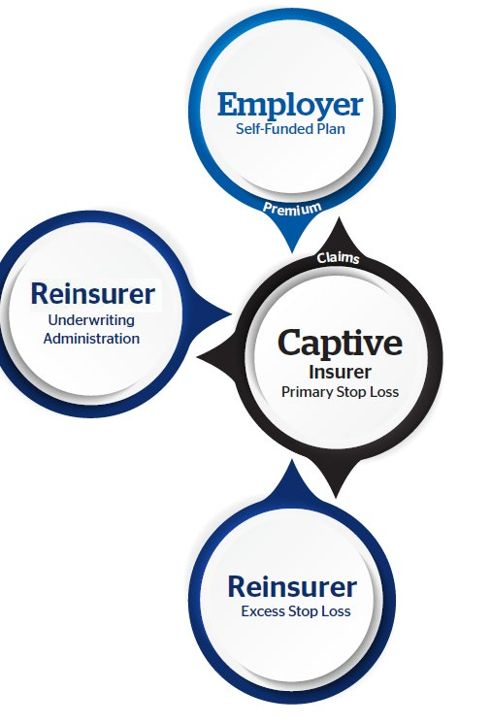
SINGLE PARENT CAPTIVE
A single-parent captive is formed as a subsidiary of another larger entity (known as a “parent”), to insure the risks of its parent. Large employers that are already self-funded may be able to increase their levels of stop-loss insurance they purchase so they can offset their exposure through a captive layer.
Funding layers of stop loss coverage through a single-parent captive,
as opposed to simply paying claims within the same layers from
general assets allow the employer to more easily recognize and
deploy underwriting profit.
Surplus derived from the underwriting and investment return from the captive can be returned to the employer more efficiently in the
form of dividend distributions, offsetting future plan costs, or
retained within the captive to smooth financial volatility associated
with other lines of insurance coverage.

Slide 8

GROUP CAPTIVE (MOST COMMON IN MEDICAL STOP-LOSS)
Owned by multiple, unrelated employers pooling similar risk layers
Risk is diversified across the group, reducing volatility
Professional management and standardized governance
Lower capital requirements per employer compared to single-parent captives
Most scalable and sustainable structure for employer health plans

Slide 9

HOMOGENEOUS GROUP CAPTIVE
Members share similar characteristics (industry, size, plan design)
Improves actuarial predictability and underwriting precision
Reduces cross-subsidization between dissimilar risks
Common in industry-specific employer groups
Often delivers more stable long-term renewal outcomes

Slide 10
Heterogeneous Group Captive
HETEROGENEOUS GROUP CAPTIVE
Members vary by industry, size, or workforce demographics
Broader diversification can reduce severity concentration
Requires stronger underwriting discipline and segmentation
Often includes sub-pools or differential pricing mechanisms
More common in open-market medical stop-loss captives

Slide 11
COMPARING CAPTIVE STRUCTURES
Single-Parent: Maximum control, highest capital commitment
Group: Shared risk, shared governance, improved efficiency
Homogeneous: Predictability and stability through similarity
Heterogeneous: Diversification with stronger underwriting controls
Structure selection impacts renewal dynamics and volatility smoothing

Slide 12
CAPTIVE STRUCTURE COMPARISON (CONCEPTUAL VIEW)
Single-Parent: One employer retains and governs all risk and capital
Group: Multiple employers pool a defined volatility layer
Homogeneous: emphasize predictability through similarity
Heterogeneous: emphasize diversification with underwriting controls
Structure choice directly influences renewal volatility and capital efficiency

Slide 13
SELECTING THE APPROPRIATE CAPTIVE STRUCTURE
Single-Parent: Large employers with capital capacity and internal risk expertise
Group: Mid-market employers seeking efficiency and shared governance
Homogeneous: Industry-aligned employers prioritizing predictability
Heterogeneous: Diverse employers prioritizing diversification
Decision factors include size, stability, time horizon, and risk tolerance

Slide 14

WHY DO STOP-LOSS CAPTIVES MATTER
WHAT
HOW
WHY
A collaborative risk pool owned by participating employers.
Removes unnecessary carrier profit while preserving protection.
Creates transparency, stability, and long-term control.

Slide 15

TRADITIONAL VS CAPTIVE FLOW
TRADITIONAL STOP LOSS:
CAPTIVE
Premium
Premium
Captive
Captive
Claims
Claims
Carrier Profit
Excess Profit Returned to Members

Slide 16
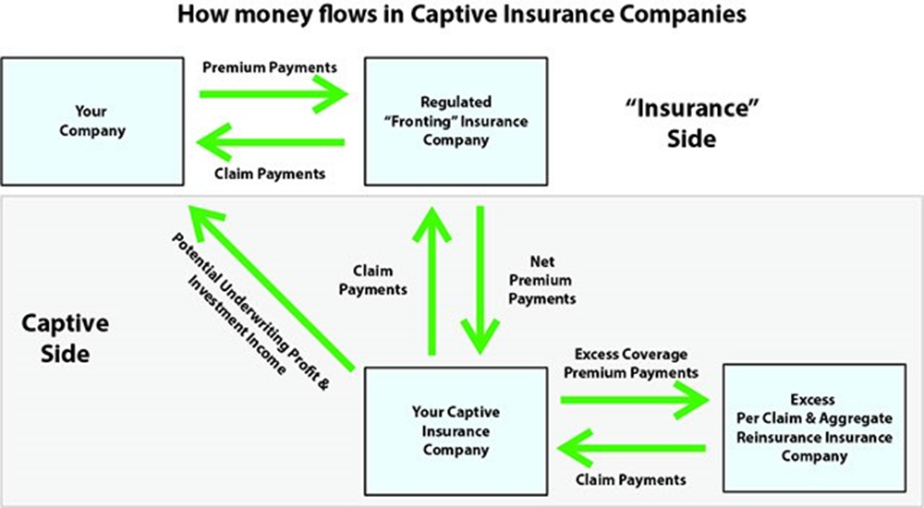

Slide 17

STOP-LOSS CARRIER ALLOCATES PREMIUM
The stop-loss carrier retains fronting and administrative fees (commonly 20-45%), possibly includes broker commissions, and cedes the remaining premium to the captive through a reinsurance agreement.

Slide 18


CAPTIVE
The captive insurer assumes a portion of the stop-loss risk, typically the specific and/or aggregate layer, and collects underwriting profit. It also can earn investment income on unused reserves.
The captive does have operating expenses that are typically in the 10-15% range. These include audit, legal, banking, licensing, compliance, and management.
The captive also will purchase reinsurance above their risk layer for larger catastrophic risk.

Slide 19


UNDERSTANDING RISK LAYERS
REINSURANCE
Tail Risk is Transferred
CAPTIVE LAYER
Volatility Is Pooled
EMPLOYER RETAINED RISK
PREDICTABLE RISK IS RETAINED

Slide 20

“CAPTIVES DON’T INCREASE RISK, THEY REALLOCATE IT INTELLIGENTLY.”

Slide 21
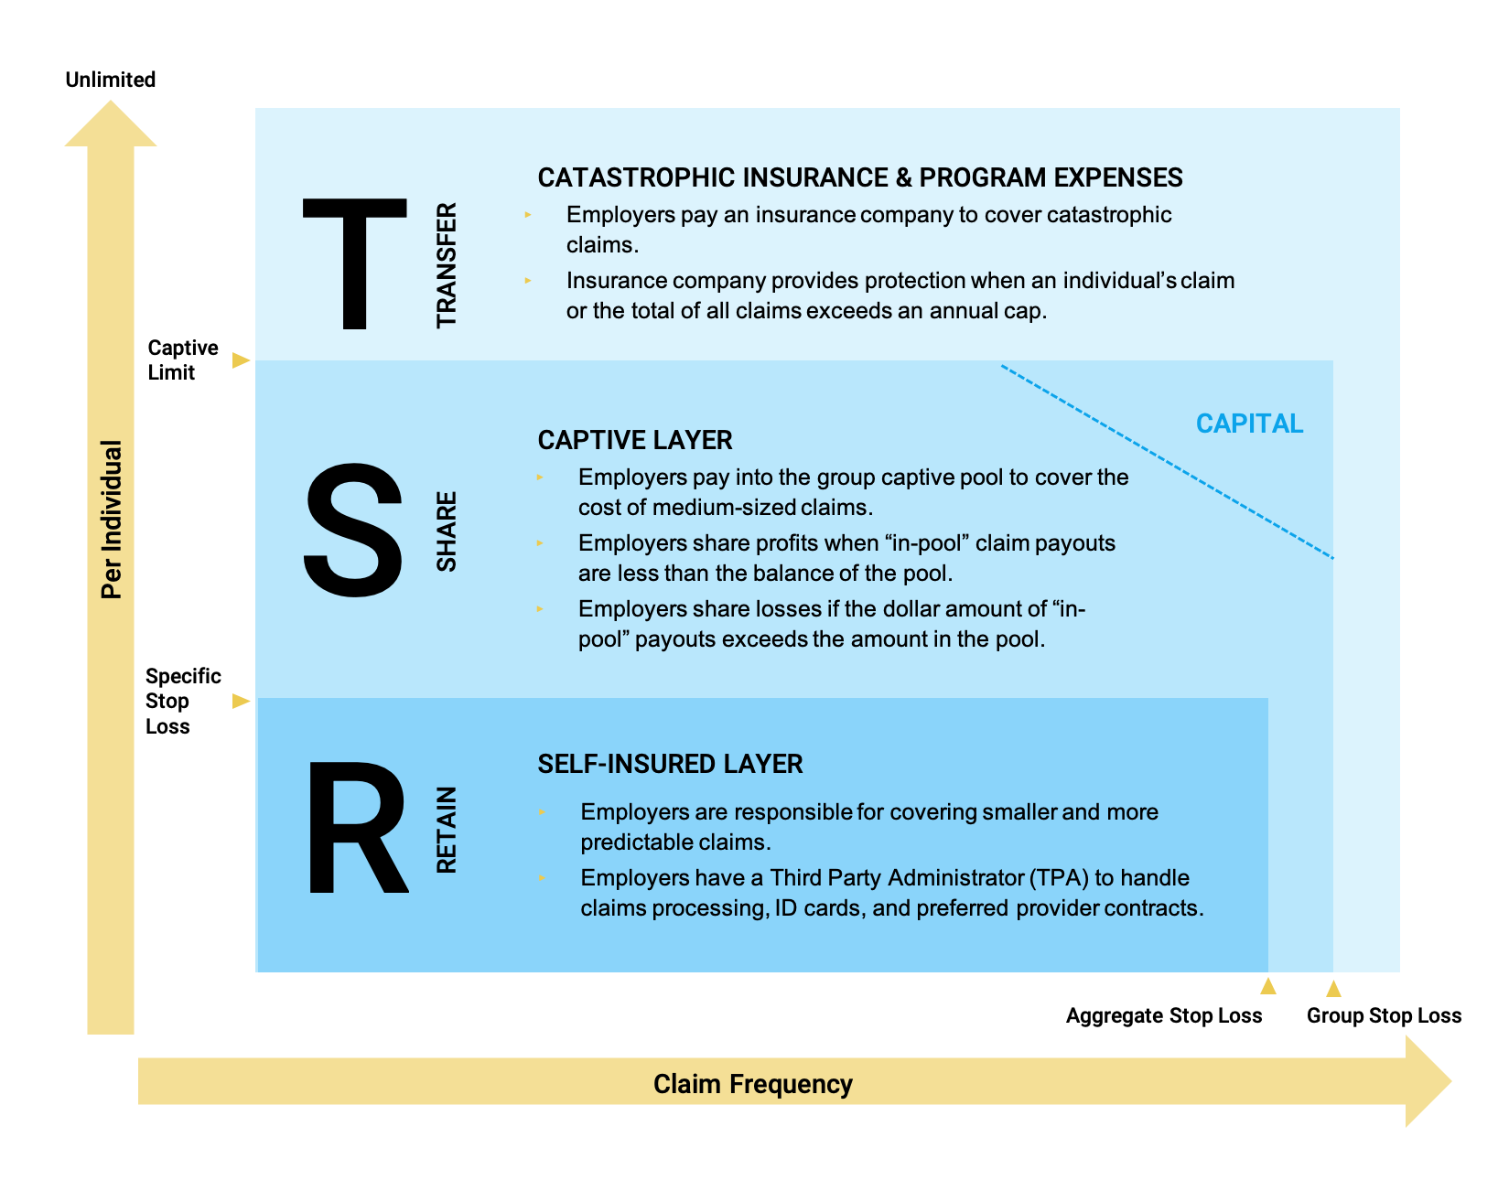

Slide 22




WHO IS A GOOD FIT FOR A CAPTIVE?
STRONG CAPTIVE CANDIDATES
50-1,000 lives
Stable population
Already Self Funded or level funded
Willing to Commit 3-5 years
Strategic approach to risk
NOT IDEAL
High turnover
Short-term cost focus
No appetite for transparency

Slide 23



UNDERWRITING & POOLING
Reducing Variance
Not Eliminating Claims
UNDERWRITING INPUTS
SUCCESS IS DETERMINED BY:
Claims history
Demographics
Plan design
Lasering strategy
Credibility Weighting
Industry Risk
WHY POOLING MATTERS
Underwriting is portfolio-based, not employer-isolated
Stability of the GROUP matters more than any single member

Slide 24

WHY RENEWAL STRATEGY CHANGES IN A CAPTIVE
Traditional stop-loss renewals focus on annual pricing.
Captive renewals focus on long-term risk behavior and capital management.
Renewal becomes a planning process, not a negotiation.

Slide 25
TRADITIONAL VS CAPTIVE RENEWAL MINDSET
TRADITIONAL
annual repricing, carrier retains upside, reactive
CAPTIVE
Multi‑year horizon, surplus participation, proactive governance
Objective shifts from lowest rate to lowest total cost of risk

Slide 26


EXPERIENCE REVIEW, WHAT MATTERS
Incurred Claims
Paid Claims
Frequency
Severity Analysis
Shock Claims
Structural Trends
Pool Performance
Individual Experience

Slide 27
SURPLUS = THE CORE RENEWAL ASSET
Surplus represents retained underwriting margin
Used to stabilize future renewals and absorb volatility
Surplus is risk capital, not short‑term savings

Slide 28
RENEWAL LEVER #1
SPECIFIC DEDUCTIBLE STRATEGY
Maintain or increase deductibles based on predictability
Strategic use of lasers where data supports it
Captive pooling reduces individual volatility

Slide 29

RENEWAL LEVER #2
AGGREGATE COORDIOR DESIGN
Aggregates manage frequency risk
Corridor width influences volatility smoothing
Captives allow more rational aggregate pricing

Slide 30

RENEWAL LEVER #3
RISK LAYER OPTIMIZATION
Employer retained layer (expected losses)
Captive pooled layer (volatility band)
Reinsurance layer (catastrophic protection)

Slide 31

RENEWAL LEVER #3
REINSURANCE STRATEGY
Attachment point and limit optimization
Market cycle awareness
Loss credibility improves long‑term pricing efficiency

Slide 32

RENEWAL LEVER #5
CAPITAL & COLLATERAL PLANNING
Traditional collateral is a sunk cost
Captive capital may offset future premiums
Capital planning should be multi‑year

Slide 33

VOLATILITY SMOOTHING OVER TIME
Traditional stop‑loss often produces sharp rate swings
Captives' smooth volatility through pooling and surplus
Predictability improves budgeting and governance

Slide 34
MULTI‑YEAR RENEWAL MODELING
3–5 year forward projections
Favorable, expected, and adverse scenarios
Focus on total cost of risk and surplus trajectory

Slide 35
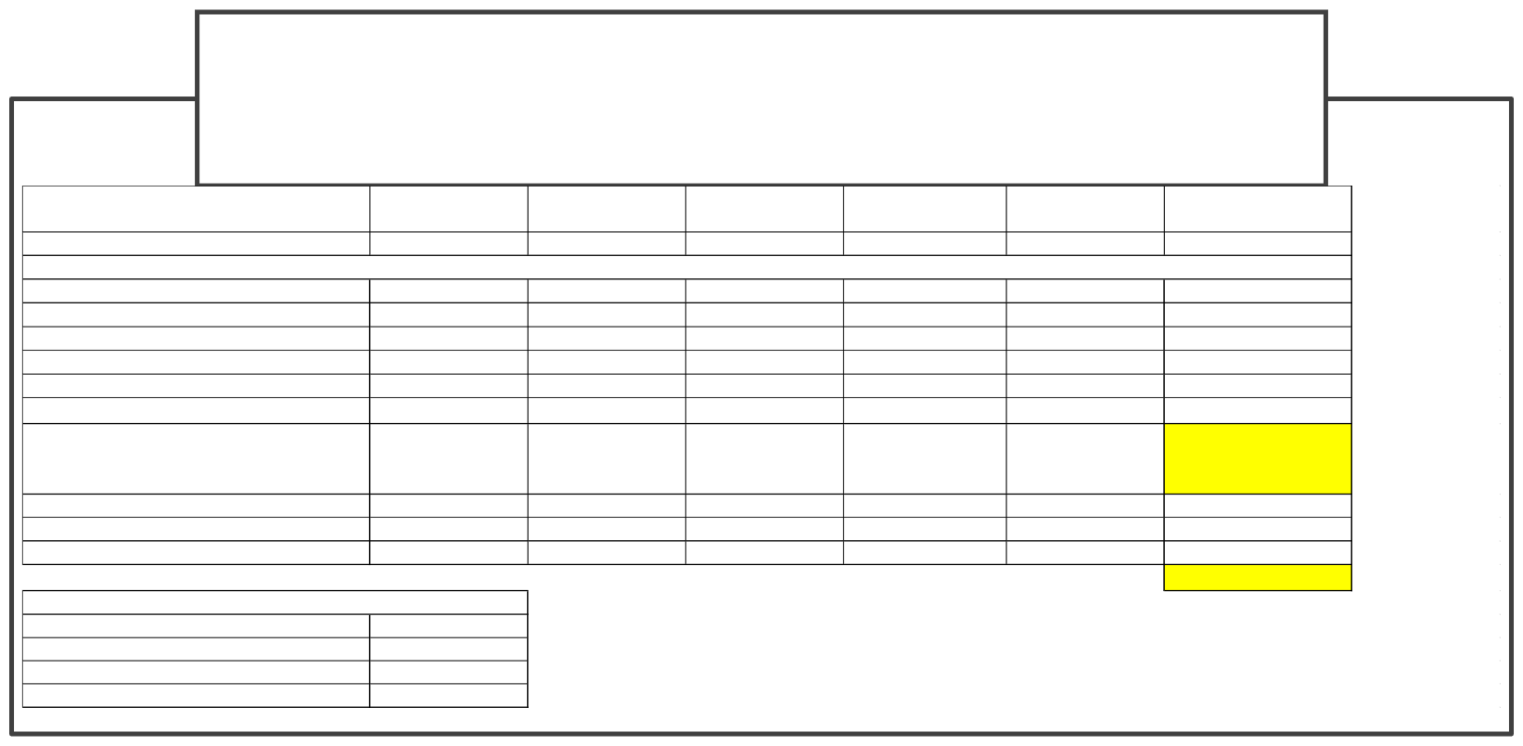
ANALYSIS –5 YEAR PROFORMA
Current
Year 2
Year 3
Year 4 $
Year 5
Totals $
Anthem
$
50,840,424
$
53,890,850
$
57,124,301
60,551,759
$
64,184,865
286,592,199
Member Group Reinsurance Prem.
Captive Expenses (Excess Ind)
Captive Expenses (Excess Agg)
Captive Net Premium
Investment Return
Captive Layer Claims ($150-500k)
$ 5,997,542.16
Cap tiv e
$
$
$
$
$
$
6,553,676.25
1,609,665.55
133,312.69
4,810,698.01
262,147.05
3,229,188.39
$
$
$
$
$
$
6,750,286.54
1,657,955.51
137,312.07
4,955,018.95
270,011.46
3,326,064.04
$
$
$
$
$
$
31,841,765.85
7,820,739.31
647,714.57
23,373,311.98
1,273,670.63
15,689,371.37
$ $ $ $ $
$
6,177,468.42 1,517,264.16 125,660.00 4,534,544.26 247,098.74
3,043,819.76
$ $ $ $ $
$
6,362,792.48 1,562,782.08 129,429.80 4,670,580.59 254,511.70
3,135,134.36
$
$
$
$
$
1,473,072.00
122,000.00
4,402,470.16
239,901.69
2,955,164.82
*includes
Investment
Return
Captive Layer Surplus Administrative Fees Projected Claims
Total
$ 1,687,207.03 $ 3,725,760.00 $ 38,237,150.50
$ 46,273,245.63
$ 1,737,823.24 $ 3,725,760.00 $ 39,384,265.02
$ 47,549,670.20
$ 1,789,957.93 $ 3,725,760.00 $ 40,565,792.97
$ 48,864,387.51
$ 1,843,656.67 $ 3,725,760.00 $ 41,782,766.75
$ 50,218,546.33
$ 1,898,966.37 $ 3,725,760.00 $ 43,036,249.76
$ 51,613,329.92
$
$
$
$
$
8,957,611.24
18,628,800.00
203,006,224.99
244,519,179.60
4 2,073,019.36
5 Year Savings
Assumptions on Annual Increases
Anthem Increase Reinsurance Increase Fees Claims
6% 3% 0% 3%

Slide 36
Claims Reimbursement Process
If a claim exceeds the group's stop-loss deductible or weekly aggregate accommodation, the TPA submits it to the stop-loss carrier.
The carrier issues payment to the TPA.
Then seeks reimbursement from the captive if the claim falls within the reinsured layer owned by the captive.
Once the contract term is up. The captive, employer group, and the stop loss carrier all ‘settle-up’.

Slide 37

SAMPLE CLAIM PAYMENT FLOW
Total Claim: $400,000
Employer Responsibility:
- Employer has a $25,000 specific deductible.
- Pays the first $25,000 of the claim.
Captive Responsibility:
- Captive reinsurer assumes the next $200,000 of the claim.
- Pays from its ceded stop-loss premium reserves.
Stop-Loss Carrier Responsibility:
- Fronting carrier covers the remaining $175,000.
- Carrier may seek reimbursement from the captive for the ceded layer.
Reimbursement Flow:
- TPA submits claim to stop-loss carrier.
- Carrier reimburses TPA or employer for amounts above deductible.
- Captive reimburses carrier for its assumed portion of the risk.

Slide 38

DISTRIBUTION OF SURPLUS AFTER PLAN YEAR
Claims Fund Surplus Distribution
- 100% of Unused dollars in the employer's claims fund are returned at the end of the contract year.
- Subject to terms such as run-out period, and reconciliation timing. (12/15 or 12/18 + 3 months)
- Enhances employer value, encourages better health plan engagement and outcomes.
Captive Surplus Distribution
- At the end of the contract term, underwriting profits retained by the captive WILL be distributed to participating groups.
- Distribution is based on contribution to premium, claims performance, and participation terms outlined in the captive participation agreement. (SAPA)

Slide 39

WHY BROKERS SHOULD CARE
BROKER BENEFITS
BROKER EVOLUTION
Quoting → Structuring
Renewal chasing → Risk strategy
Transactional → Advisory
Differentiated value
Deeper client relationships
Long-term revenue stability
YOU ARE NO LONGER JUST A BROKER. YOU ARE A RISK STRATEGIST.

